Slide 1
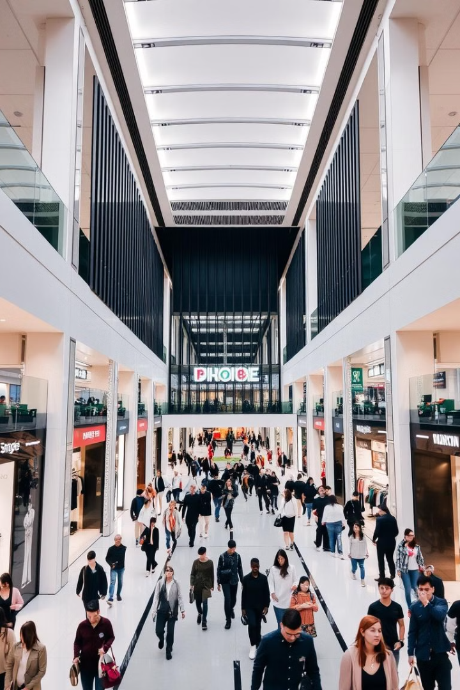

Mall Customer Segmentation Using K-Means Clustering
This presentation explores customer segmentation using K-Means clustering, a powerful technique for identifying distinct groups within a dataset.
by Naresh Reshmon

Slide 2

Understanding the Data
Key Features
Objective
The analysis focuses on two key features: annual income and spending scores.
The goal is to segment customers based on their unique income and spending patterns.

Slide 3
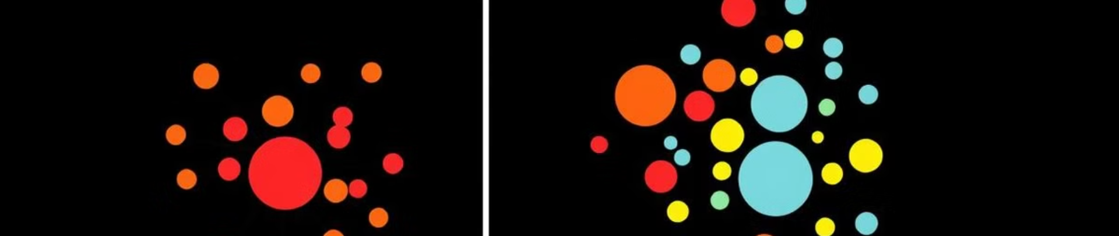

K-Means Clustering Algorithm
1
Iterative Process
2
Optimal Number of Clusters
The algorithm iteratively assigns data points to clusters based on their proximity to cluster centroids.
The "elbow" method was used to determine the optimal number of clusters, which was found to be 5.

Slide 4
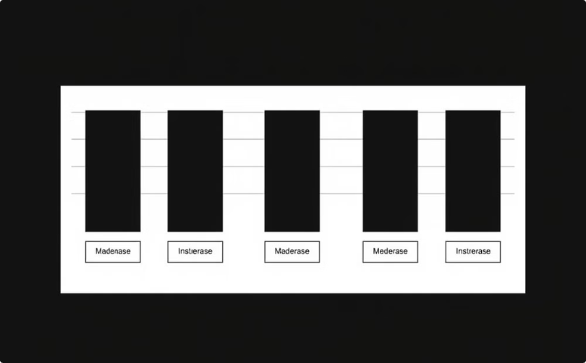

Visualizing Customer Segments
Cluster Distribution
The bar chart visualizes the distribution of customers across the five identified segments.

Slide 5
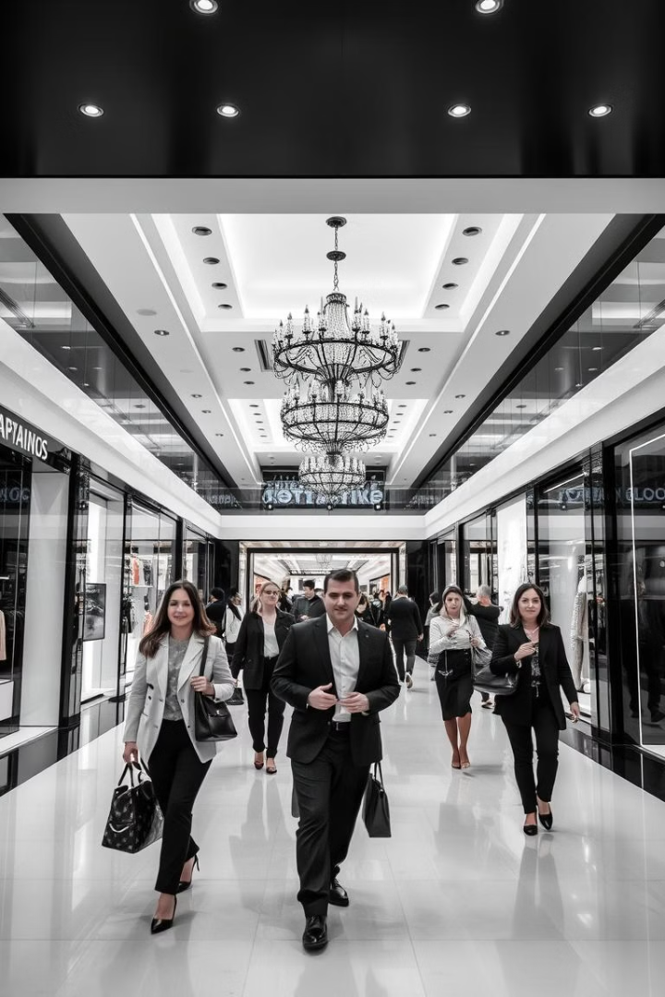

Segment 1: High Income, High Spenders
Characteristics
Marketing Recommendations
Customers in this segment have high incomes and spend significantly at the mall.
Target them with exclusive promotions, loyalty programs, and personalized experiences.

Slide 6
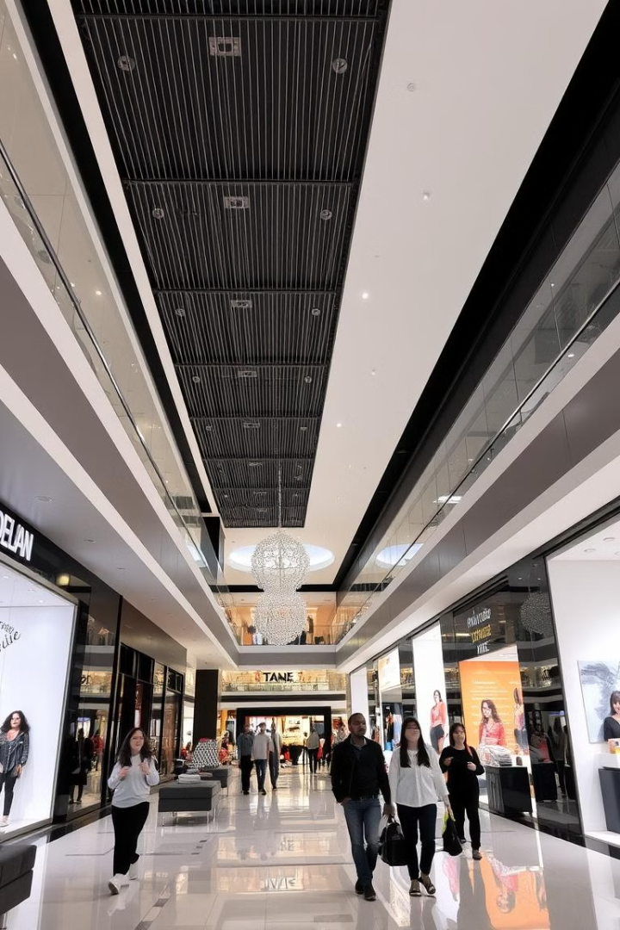


Segment 2: Moderate Income, Moderate Spenders
Value-Oriented
Loyalty Programs
These customers are price-sensitive and seek value for their money.
Offer loyalty programs with rewards and discounts to encourage repeat purchases.

Slide 7
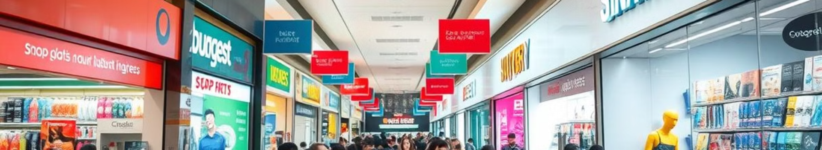

Segment 3: Low Income, Low Spenders
Price Sensitivity
This segment is highly price-conscious and seeks affordable options.
1
2
Targeted Promotions
Run promotions and discounts on essential items to attract this segment.

Slide 8
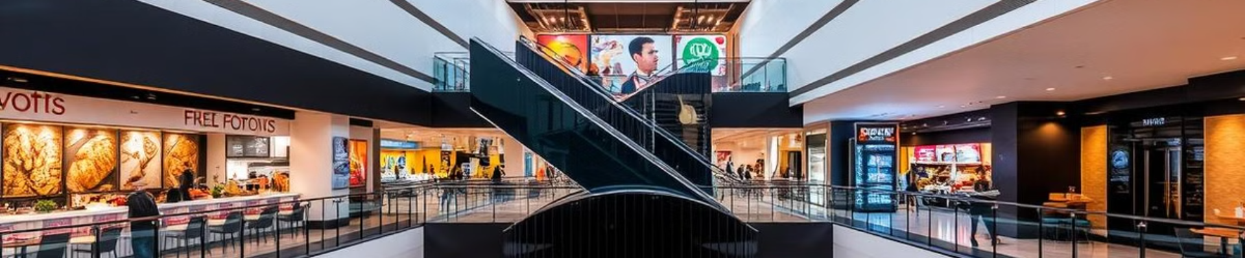



Segment 4: High Income, Low Spenders
Potential
Attracting New Customers
These customers have high incomes but may not be frequent mall shoppers.
Offer exclusive events, experiences, and promotions to attract this segment.

Slide 9




Segment 5: Low Income, High Spenders
Understanding Needs
1
Financial Assistance
2
Offer flexible payment options and financial assistance programs.

Slide 10
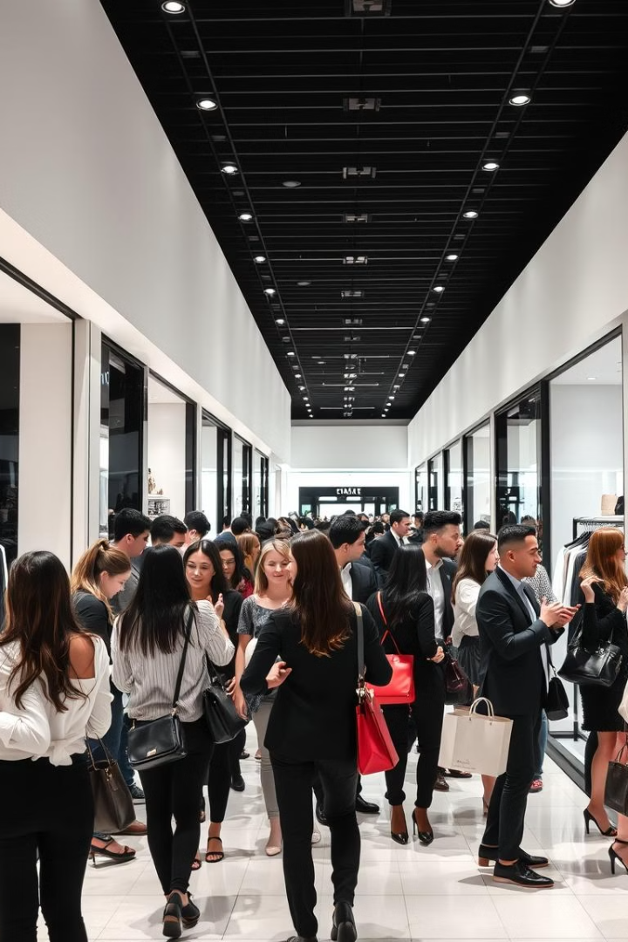
Conclusion: Tailored Marketing Strategies
By understanding the unique characteristics of each customer segment, malls can develop tailored marketing strategies to maximize customer engagement and drive sales.

